Slide 1


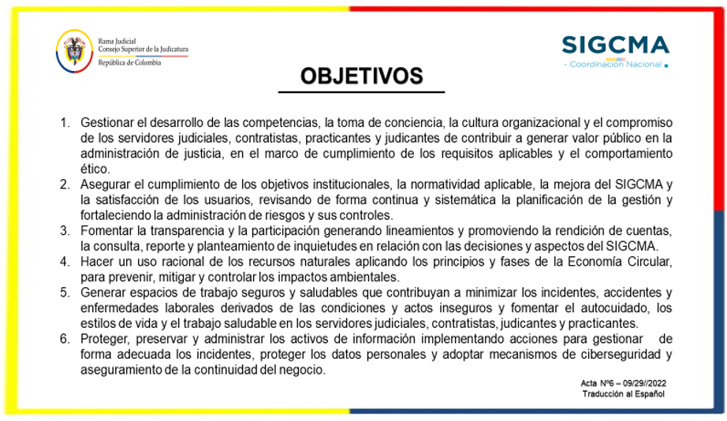




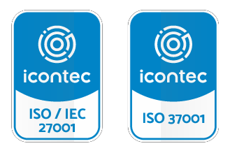



5781-1 SA-CER-551308 ST-CER955060 SI CER9669331 SGA-2000495 CP-CER-PB0655 RJ-CER855787

